Slide 1
Data Management for Information Technology (MSIT 3860) Final Project
-Nandini Vimala Motupalli

Slide 2
Outline of the Presentation
Personal Experience
03
Extra Credit Questions and Answers
01
02
Business Questions and Answers

Slide 3
Yelp Users since 2010
1. How many users have joined Yelp since 2010?
The number of users who have joined Yelp since 2010 is 1870099.
Based on the graph, it can be seen that the peak year for new users was 2015 after which there is a downward trend.
The registrations reached an all time low in 2022.

Slide 4
Number of Elite Users
2. How many users were elite in each of the 10 years from 2012 through 2021? Does it look like the number of elite users is increasing, decreasing, or staying about the same?
The number of elite users kept increasing from 2012 to 2019.
It was then followed by a period of slight decline in 2020 following which it increased again to the previous count of higher number of users.

Slide 5

Most 5-star reviews
3. Which of our users has the most 5-star reviews of all time? Give us the person’s name, when they joined Yelp, how many fans they have, how many funny, useful, and cool ratings they’ve gotten. Please also gives us 3-5 examples of recent 5-star reviews they have written.
"Love love love this place! Great food and always two meals with the portions. Service is always friendly too!"
Name | Fox
Joined Yelp | 5/26/2009 11:33
Number of fans | 3493
Funny Ratings | 185823
Useful Ratings | 206296
Cool Ratings | 195814
"Such yummy food and great customer service! I also had some delicious hot chai. The restaurant was empty and quiet, most of their customers were take away, so we got our food fairly quick. Everything we ordered was delicious highly recommend!"
"Jerry did an excellent job! My car is running great. He especially cares about, and I believe even offers discounts for the University students. He answers any questions you may have and is super helpful."

Slide 6
Relationship between business hours and reviews
4. We are wondering if there is any relationship between a business’s hours of operation and the reviews they receive. Can you give us a spreadsheet giving the following information for every business we have in our database: business id, business category, and total hours of operation per week (i.e., the total number of hours each business is open across the entire week).
There are about 594858 rows in the table generated for this query. To answer this question here is the sample data for three businesses.

Slide 7
States with the most businesses
5. Which US states have the most businesses in our database? Give us the top 10 states.
Pennsylvania and Florida have the highest number of businesses in the US.
California despite being densely populated has the least number of businesses in the top 10 states.

Slide 8
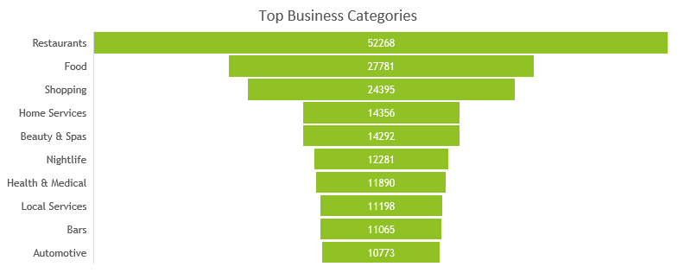
Top Ten Business Categories
6. What are our top ten business categories? In other words, which 10 categories have the most businesses assigned to them?

Slide 9
Average Business Ratings
7. What is the average rating of the businesses in each of those top ten categories?
The Beauty & Spas category stands out with the highest average rating, indicating overall satisfaction.
Automotive and Home Services categories show relatively lower ratings. This suggests that there are areas of improvement which will help them increase their average rating.

Slide 10
Funny and unfunny reviews
8. We’re wondering what makes users tag a Restaurant review as “funny”. Can you give us 5 examples of the funniest Restaurant reviews and 5 examples of the least funny?
Funniest Reviews Least funny reviews

Slide 11
We’d also like you to look at a larger set of funny and unfunny reviews and tell us if you see any words or phrases that are commonly found in the funniest reviews. (We know the last part is qualitative but tell us anything you see that may be useful.)
After analysing 1000 funny reviews and using a frequency analysis tool these were the words which are most commonly present in the funniest reviews and their frequency.
great: 520
time: 517
restaurant: 505
chicken: 491
delicious: 368
cheese: 351
nice: 314

Slide 12
Relation between tips and compliments
9. We think the compliments that tips receive are mostly based on how long the tip is. Can you compare the average length of the tip text for the 100 most-complimented tips with the average length of the 100 least-complimented tips and tell us if that seems to be true? (Hint: you will need to use computed properties to answer this question).
Average length of tip text for the 100 most-complimented tips: 146.63 characters
Average length of tip text for the 100 least-complimented tips (49.55 characters)
There seems to be a positive correlation between the length of the tip text and the number of compliments it receives. However, further analysis of more data is required to confirm this relationship.

Slide 13
What factors influence reviews?
10. We are trying to figure out whether restaurant reviews are driven mostly by price range, how many hours the restaurant is open, or the days they are open. Can you please give us a spreadsheet with the data we need to answer that question? (Note from Professor Augustyn: You don’t actually have to hand in a spreadsheet…just give me a table with 10 rows of sample data returned by your query.)
We would need the average hours per week that the restaurant is open, the days that it is open and the number of reviews as well so that we can identify that drives the reviews the most.

Slide 14
Extra Credit Questions
Categories with the longest reviews
Which business categories have the highest average review length?
Fencing clubs have the highest average review length with approximately 1538.2 words in a review.
In the top 10 categories, there is a similar review length starting from races & competitions to makerspaces.

Slide 15
Business closed on weekends vs weekdays
2. Which businesses operate solely during the weekdays and which operate only during the weekends?
38,949 businesses are closed during weekends.
23552 businesses only operate during the weekends and are closed the rest of the week.

Slide 16
Personal Experience
1. What was your biggest challenge in working with this data? How did you overcome it?
The biggest challenge I encountered while working with this data was the encoding mismatch. Whenever I attempted to load the file, I encountered an encoding error because pgAdmin uses WIN1252 format, whereas our files need to be UTF8 encoded. I managed to overcome this obstacle by making a slight modification during the file loading process, ensuring that the encoding was converted to UTF8. Here's the command:
\copy businesses FROM 'C:\Users\Nandini\OneDrive\Desktop\businesses.csv' WITH (FORMAT csv, DELIMITER ',', HEADER false, ENCODING 'UTF8');

Slide 17
2. What was the easiest part of the project for you (downloading the data from Moodle doesn’t count!)? What made it easy?
The easiest part of the project for me was creating the ERD. We had already gained experience with the Spotify ERD diagram and had practiced mapping one-to-one and one-to-many relationships, which made it straightforward to draw this ERD.

Slide 18
3. Was there anything that surprised you about the data?
I was surprised by the sheer volume of the data, particularly the review data. With 30 review files containing millions of rows each, it was a massive dataset to work with. Similarly, the number of attributes for each business was also more than my initial expectation.
Another surprising aspect was how well-organized the data was, and how effectively it was interconnected. All the data ultimately led back to the businesses table, which shows that this is a well-structured relational database design.

Slide 19
4. Is there anything you wonder about how Yelp’s real data might look, how their database systems are designed, or what they do with this kind of data?
Maintaining data integrity across their platform would be crucial for Yelp. This involves ensuring that information about businesses, reviews, and users is accurate and up-to-date, even as it evolves over time. I wonder how that is being done from their end.
Another aspect that I wonder about is the data analysis. Yelp likely leverages their data for various purposes, including understanding user behavior, identifying trends, and improving recommendations. Exploring how they analyze and derive insights from their data is something that I would like to get to know.

Slide 20
5. Are there any changes you would recommend to Yelp to make this data easier to work with?
Developing user-friendly query and analysis tools that allow users to explore Yelp's data, run custom queries, and visualize results can help users who work with data derive insights and make data-driven decisions more effectively.
Having proper data quality assurance processes, including data validation, cleansing, and monitoring, can help maintain the accuracy, completeness, and consistency of Yelp's data, making it more reliable for analysis and decision-making.

